Slide 1

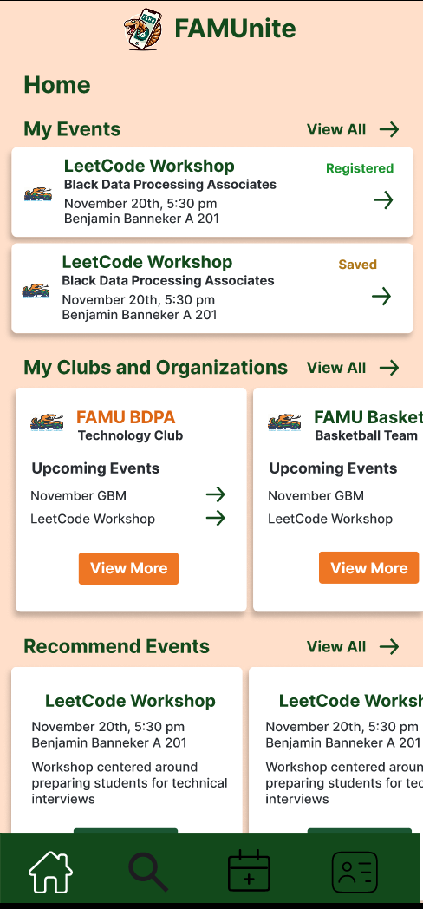
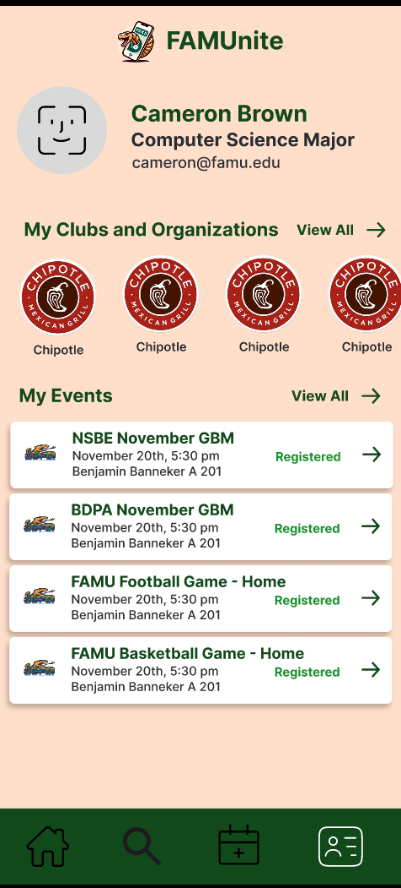
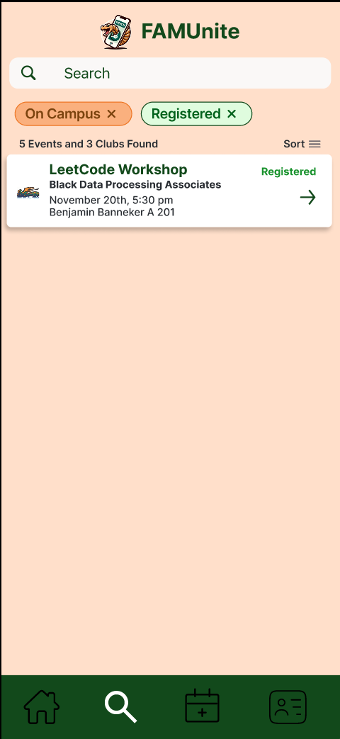
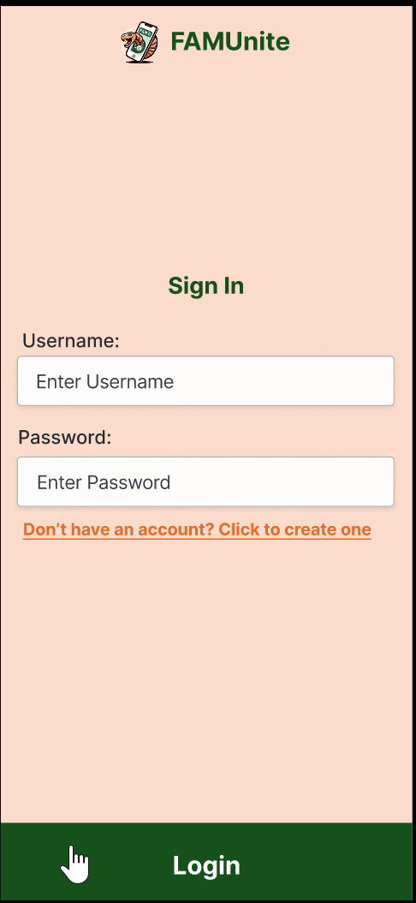
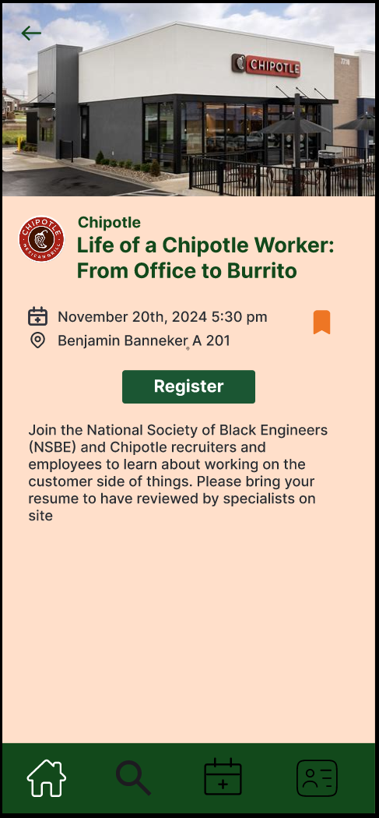
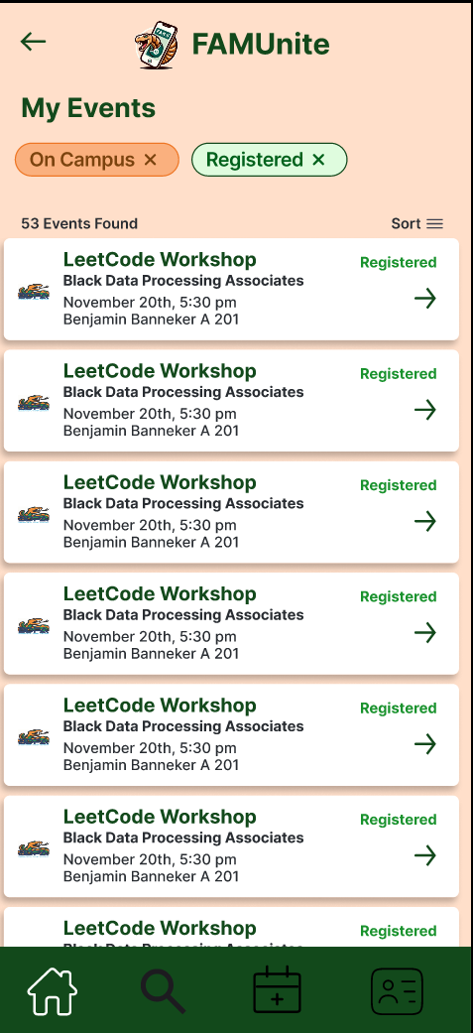
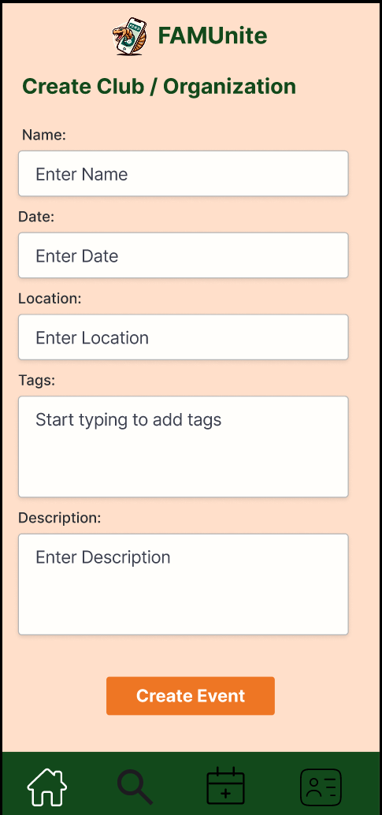
FAMUnite
Centralized user-friendly mobile/web application for FAMU clubs/organization and company events
Ideation and Design
Introduction
Wireframes
Technology
Students at FAMU have issues staying up to date with local events going on. Information is scattered between social media, iStrike, and email, which is hard to keep track off. FAMUnite will provide a centralized user friendly application. The app will enable students to view, register, save, and receive reminders for events. By integrating event data from multiple sources, it provides a single, easy-to-use platform for staying informed about campus activities.
iStrike (API): school club website used to pull club information
Instagram (API): social media application used to pull club social media information
Draw.io: System design software used to create Data Flow Diagrams (DFDs) and Entity Relationship Diagrams (EFDs)
Project Plan 365: Project Management software used to create Gantt Charts,and Work Breakdown Schedule
Figma: Design software used to create wireframes and prototype
MongoDB / FireBase: Data Schema
Google Drive / Github: Document & File Organization software used to collaborate and store project information
Process
Ideation
Idea Generation: Brainstormed possible app ideas and created a project charter
Requirements Gathering: Conducted user research, competitive research, and developed fully dressed use cases to create a list of requirements
Planning
Scope Definition: Created API descriptions, a gantt chart, and a work breakdown structure (WBS)
Timeline and Milestones: Divided work into milestones
Design
System Design & Architecture: Created data flow diagrams (DFDs) and entity relationship diagrams (ERDs) to map out system
Wireframing & Prototyping: Created low-fidelity wireframes that were converted to high-fidelity
User Interface (UI) Design: Incorporated accessibility features and created style guide
User Experience (UX) Design: Converted wireframe into interactive prototype to enhance user experience and interaction
Conclusion / Lessons Learned
Key takeaways from the development of the university event management app include that the budget and scope need to be managed from as early as possible to avoid scope creep and ensure realistic timelines. SWOT analysis was a helpful method to identify strengths (targeted student engagement, sponsor integration) and challenges (limited resources, user adoption risk). Tools such as Gantt charts and Network Diagrams were useful for visualization of task dependencies and meeting deadlines. An interactive wireframe facilitated effective user feedback in improving the interface before development. In all, effective project management has kept the project organized and on track, focused on delivering a functional, user-friendly app.
Home Page
Profile Page
Search Page
Next Steps / Future Enhancements
The next steps for FAMUnite include refining the app based on user feedback and preparing for a beta release to a wider group of students. Future enhancements may include integrating additional features like event ticketing, in-app chat for event discussions, and personalized event recommendations based on student interests. The app could also expand to include campus news, club messaging, and improved analytics for event organizers to track engagement. Ongoing updates will focus on enhancing user experience, scalability, and ensuring seamless integration with other campus systems.
Interactive Prototype
View Event Page
View all Events Page
Create Events Page

